Slide 1
Quorum Colour Palette
Modern Workplace
Managed Services
Cloud
Development
Quorum Learning
Cloud Platform
Security & Identity
Data
& AI
108, 158, 162
171, 117, 174
196, 178, 105
228, 239, 245
128, 158, 194
57, 22, 61
41, 35, 92
39, 151, 161
82, 56, 95
103, 96, 53
64, 134, 173
76, 162, 196
131, 50, 139
27, 117, 188

Slide 2
Power Query An introductory guide

Slide 3
Introduction to Power Query
Importing Data
Data Transformation
Advanced Data Transformation
Working with Query Dependencies and Steps
Error Handling
Best Practices
Bonus Materials

Slide 4
What is Power Query
Prepare
Explore
Visualize
Share &
collaborate
Notes:
Before we can pull insights from our data using Power BI, some preparation must be done first. Power Query is the tool for this.
Power Query is a no-code/low-code data transformation and integration tool used in Microsoft Excel and Power BI (Business Intelligence) suite. It allows users to easily connect to various data sources, extract data, transform and shape it according to their needs, and load it into Excel or Power BI for further analysis and reporting.

Slide 5
What is Power Query?
Data Ingestion
Data Transformation
Data Merging and Appending
Data Enrichment
Data Load
Notes:
Data Ingestion: Power Query enables you to extract data from multiple sources, such as Excel files, CSV files, databases (e.g., SQL Server, Oracle), SharePoint lists, web pages, and more.
Data Transformation: Power Query provides a wide range of transformation capabilities to clean and reshape data. To prepare it for analysis, you can perform tasks like filtering, sorting, splitting, merging, pivoting, and aggregating data.
Data Merging and Appending: Power Query allows combining data from multiple sources by merging or appending tables based on common columns.
Data Enrichment: You can merge your data with other data sources, such as lookup tables or online data sources.
Data Load: Once you have transformed and shaped your data, Power Query enables you to load it into Excel or Power BI for analysis, reporting, or further data modeling.

Slide 6
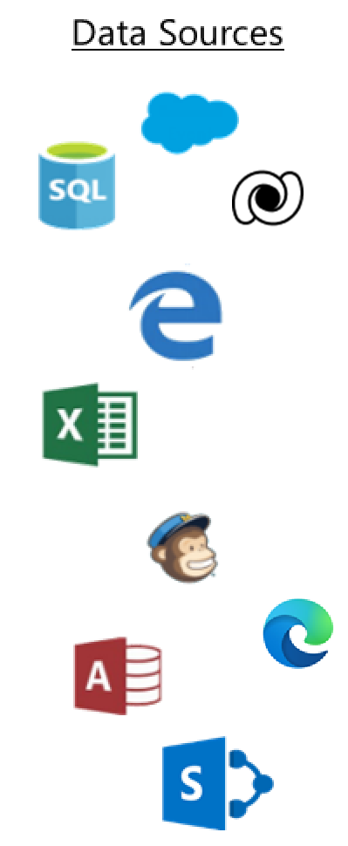

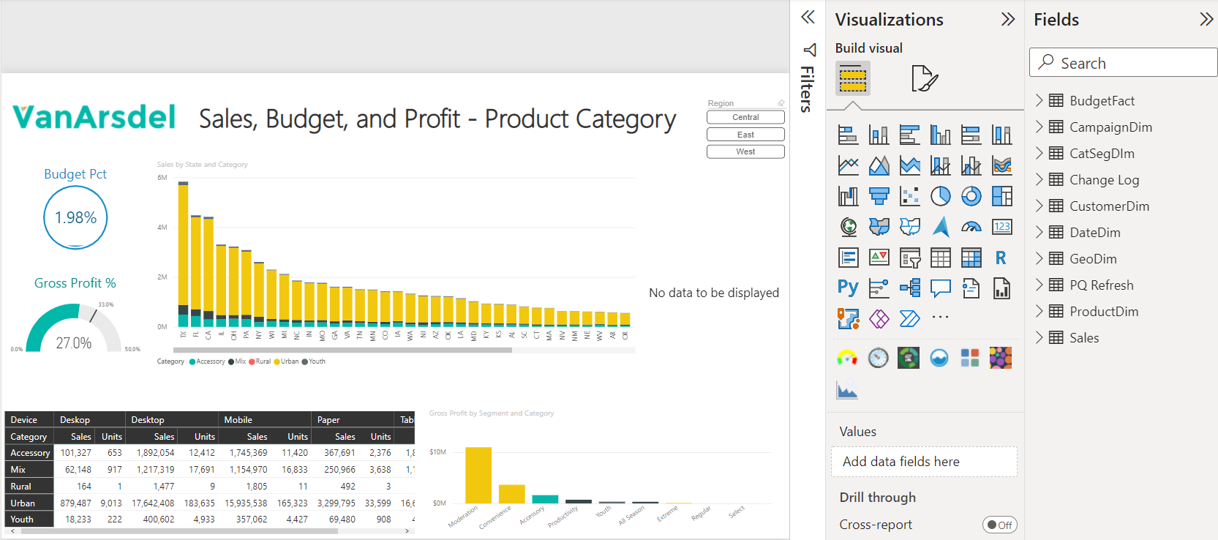
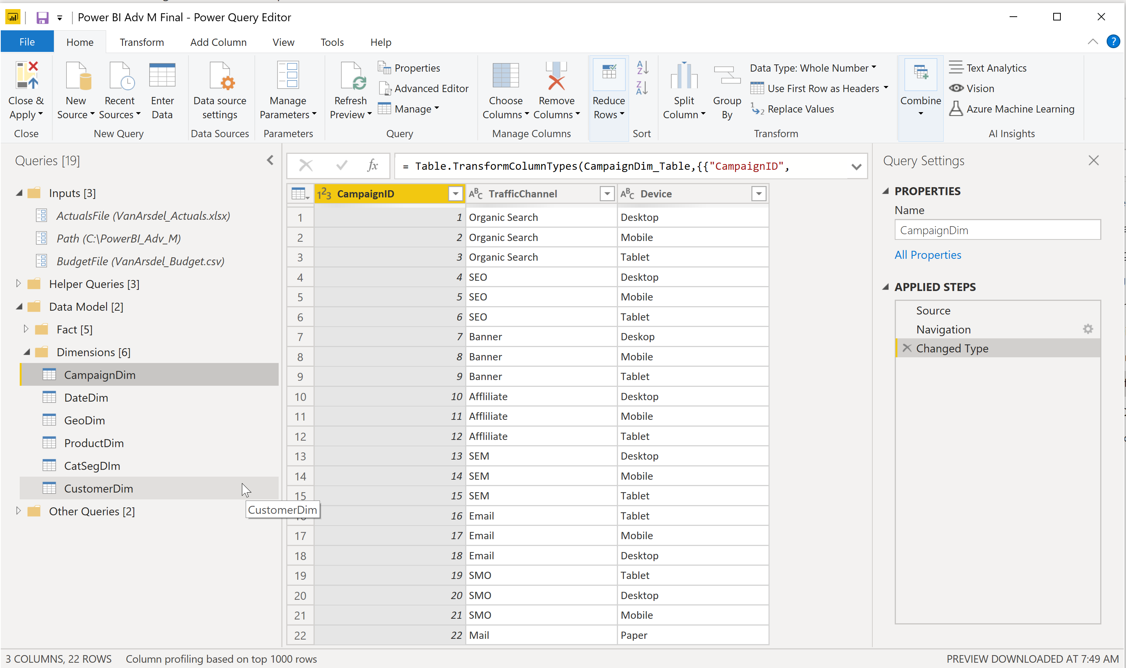

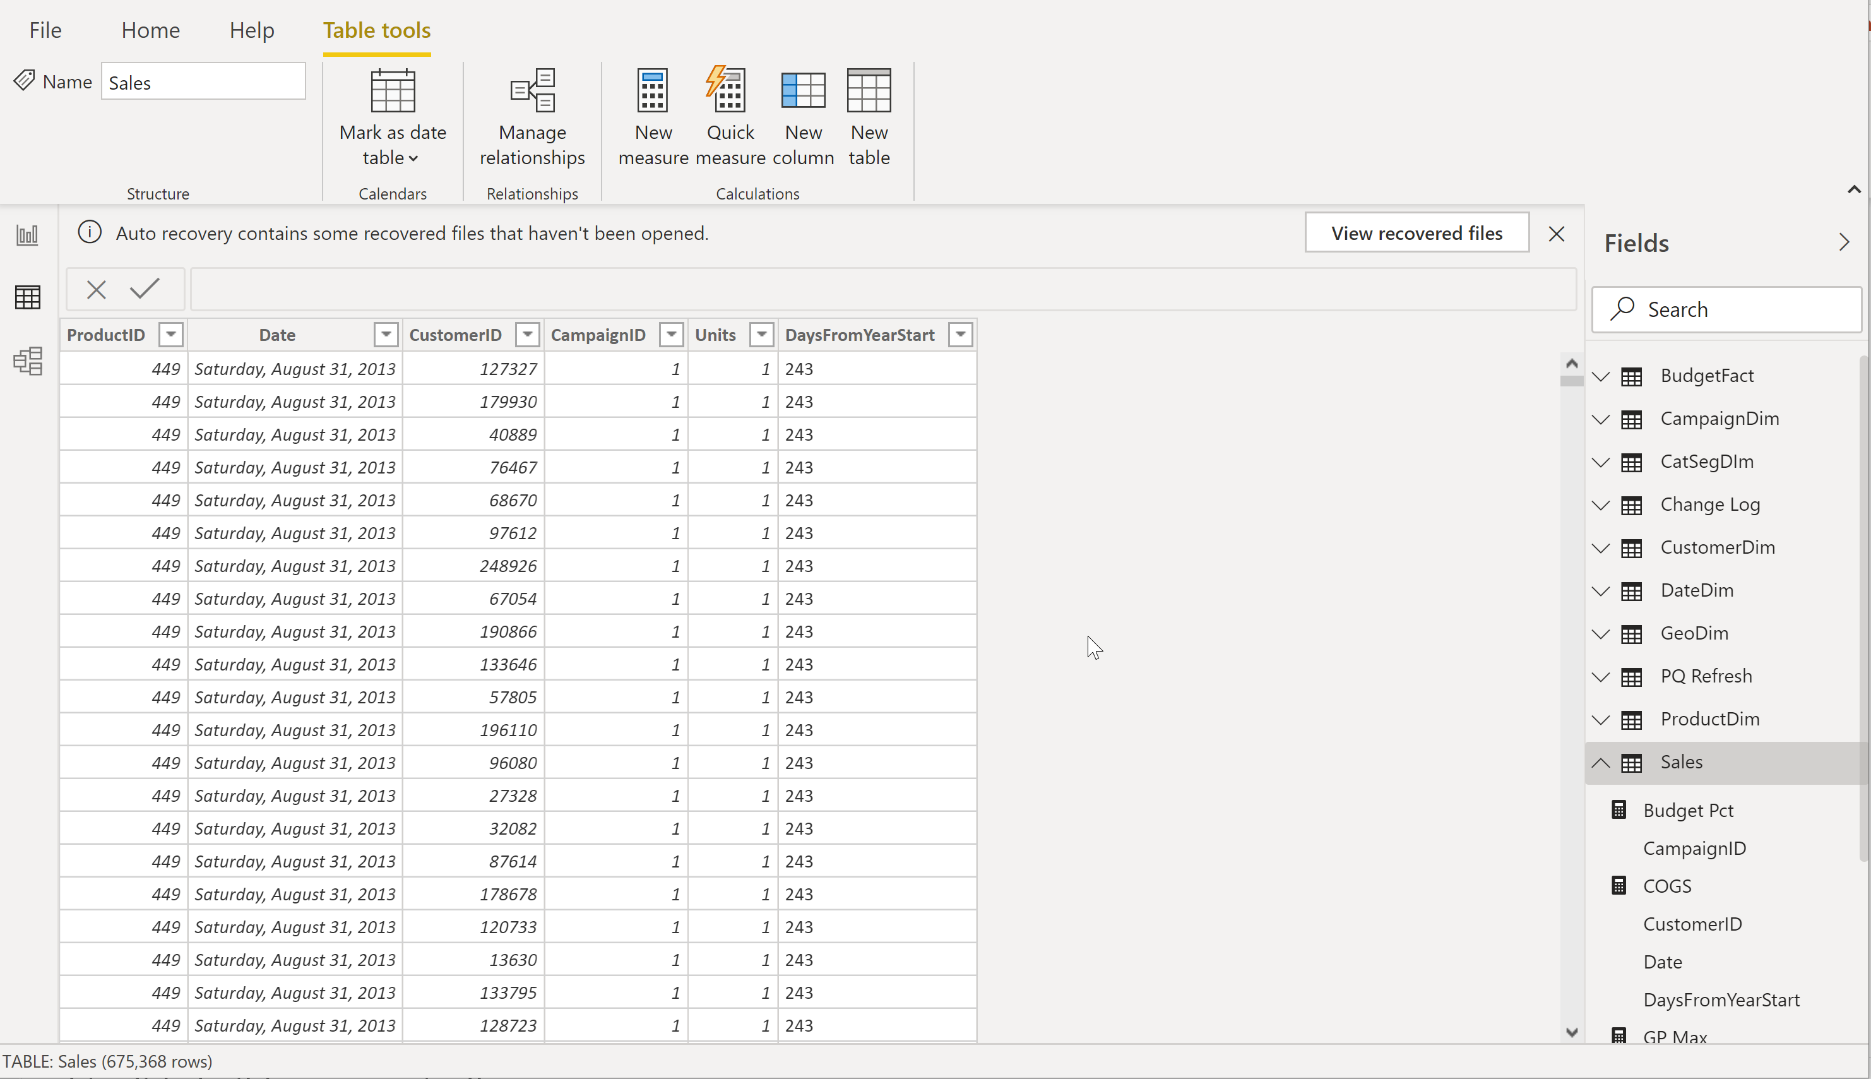
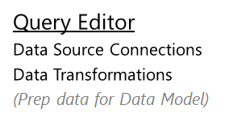

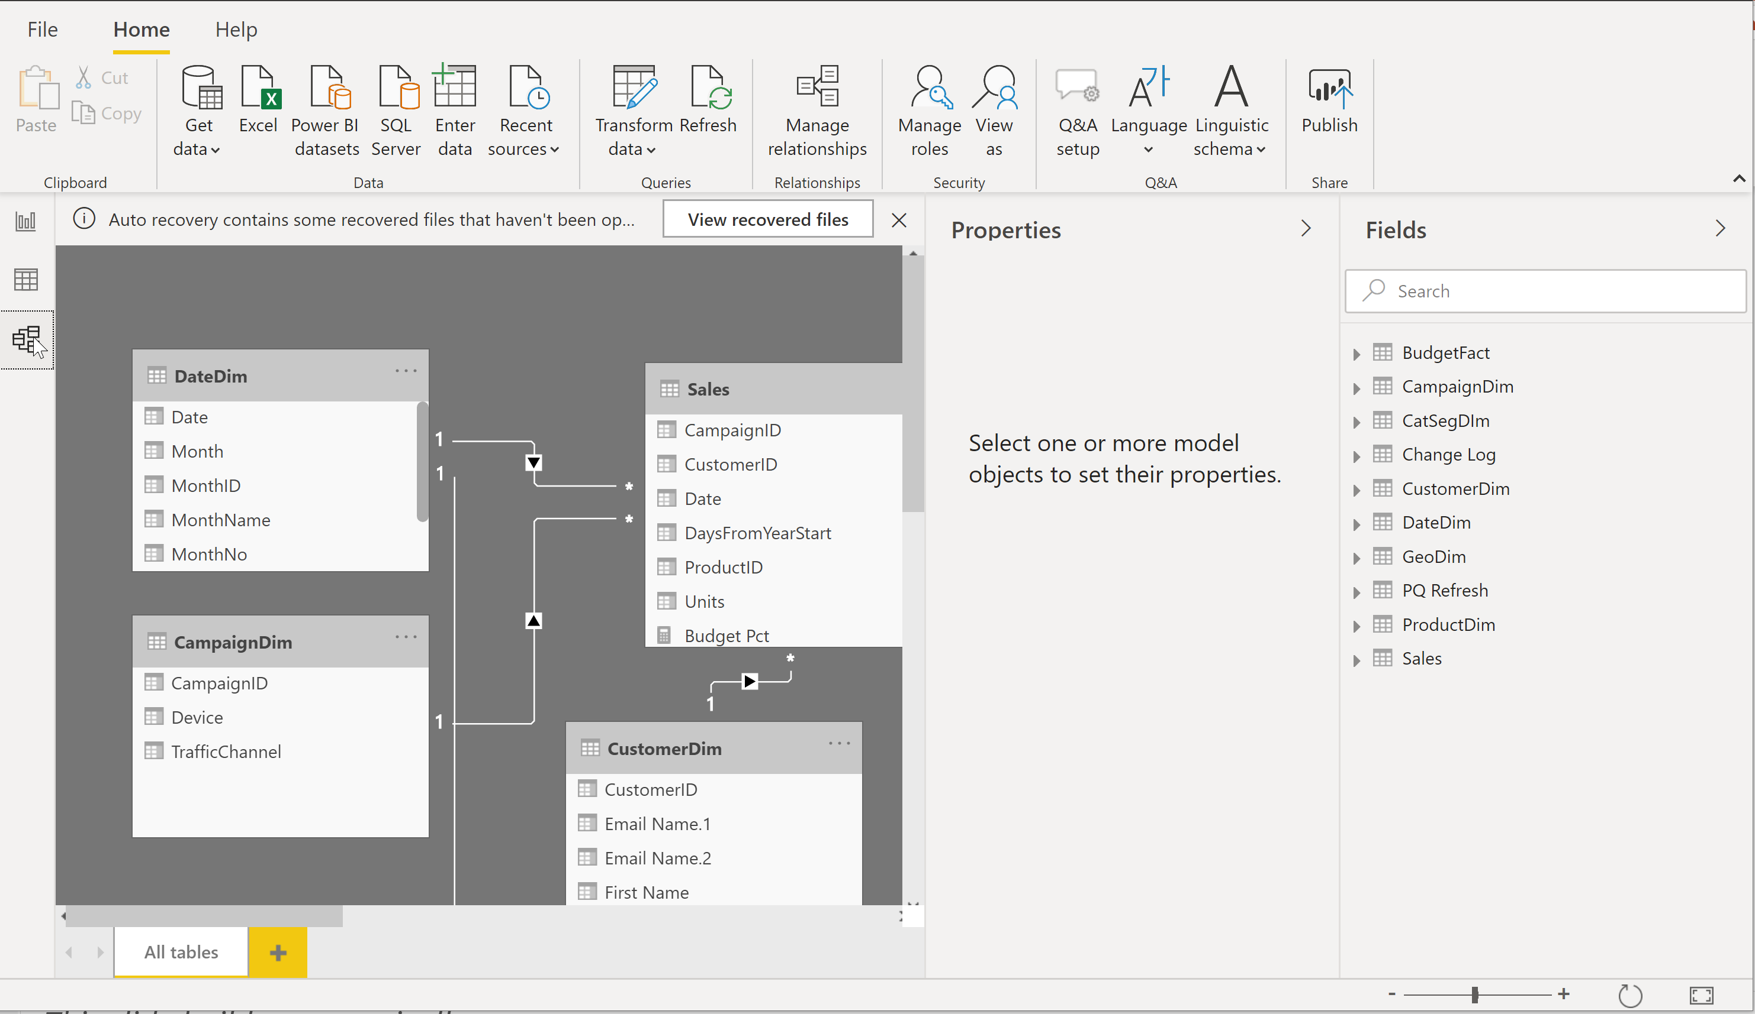
Power BI Desktop
Power BI Desktop file (.PBIX)
Report
Create visuals
Close & Apply
Close: Closes Query Editor
Apply: Loads data from sources to Data Model
Data
View tables
Relationships
See how tables relate to each other

Slide 7
Loading Data in Power Query
Demo 1

Slide 8
Columnr Database
Row Based Database
PBI - Columnar Database
First Name | Last Name | Sales
John | Smith | $10
Jane | Doe | $25
Hardy | B | $35
First Name | Last Name | Sales
John | Smith | $10
Jane | Doe | $25
Hardy | B | $35
Stores each row separately (like a separate file)
Retrieving multiple columns from a single row is fast
Retrieving multiple rows from a single column is slower
Stores each column separately (like a separate file)
Retrieving multiple columns from a single row is slow
Retrieving multiple rows from a single column is faster
Columnar databases are well suited for analytics
Notes:
Because Power BI works like a columnr database we what our data to be in a long format. Doing this will improve our models’ performance and size ,plus give us other benefits.

Slide 9

Data Structure
Star Schema vs Flat File
Notes:
To prevent tables getting to wide we can use a starred schema data model. Structuring our data this way has many pros in Power BI some of which we will cover later.

Slide 10

Tidy Data
Variables
Observations
Values
Notes:
Some principles to follow when transforming data.
Every variable should have its own column.
Every observation should have its own row.
Every values should have its own cell.

Slide 11
Transforming Data in Power Query
Demo 2

